Slide 1
AI in the Energy Sector: Transforming Smart Cities and Power Systems
20 February 2024 | WEBINAR

Slide 2
Housekeeping Rules
Please keep your microphone muted and your video off unless you are taking the floor
When you take the floor please say state your name, your organisation, and where you are based
You can at any time during the webinar write your questions in the chat for the Q&A and panel discussion session
The event will be recorded for dissemination purposes

Slide 3
Agenda
Time | Content | Speaker | Speaker BIO
15:30-15.40 | Welcome and introduction | Luigi LO PIPARO Shazade JAMESON (Moderator) | Partner at Technopolis Group and SCM Matchmaking Coordinator Principal Consultant at Technopolis Group
15:40-15.50 | Smart Cities Marketplace | Marta FIORILLO | Green Economy Specialist at Technopolis Group
15.50-16.00 | OASC & MIMs | Michael MULQUIN | MiMs Ambassador for Open and Agile Smart Cities, with a long history of developing and implementing socially-inclusive, area-based ICT strategies.
16.00-16.10 | ThermAI | Ward STEEMAN | Project Manager IT & Smart Cities at the West-Vlaamse Intercommunale, an association of municipalities in West Flanders
16.10-16.20 | Urban Strategy | Bart VUIJK | Senior International Business Development Manager at TNO, focusing on Smart Mobility & Smart Cities. He is also one of the team leaders of the Urban Strategy in Amsterdam.
16.20-16.30 | Dutch Metropolitan Innovations | Caspar DE JONGE | Program manager Mobility & Transitions at the Dutch Ministry for Infrastructure & Water Works. He is also leading the Dutch Metropolitan Innovations project.
16.30-17.15 | Panel discussion + Q&A
17.15-17.30 | Closing Remarks

Slide 4
Means, pace and scale of the transition
The EU Green Deal set to to make Europe the first climate neutral continent by 2050
Binding climate targets
Investments
Attention to ensure that the process benefits all parts of society and supports the citizens and territories most exposed to the costs of decarbonisation (Just transition)
Companies and cities are adapting to reduce climate risk...
...but the pace and scale of adaptation need to significantly increase.

Slide 5
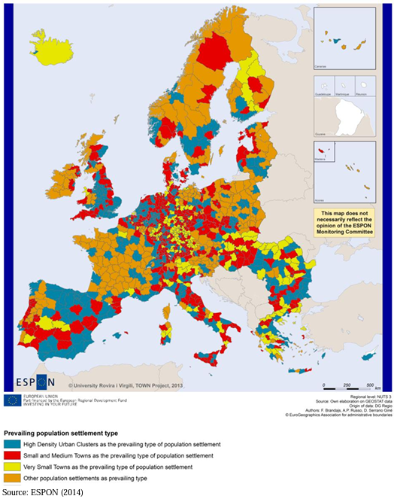
Cities as catalysts for environmental and economic progress
4% of the EU’s land area
home to 75% of EU citizens
66% of EU citizens reside in areas with < 500k inhab.
43% of EU citizens reside in areas between 5k and 50k inhab (ESPON, 2014).
consume over 65% of the world’s energy and
account for more than 70% of global CO₂ emissions

Slide 6
Main barriers to climate neutrality
Lack of funding / financing schemes
Fragmentation of responsibilities
Lack of human resources or skills
Disconnection strategy – actions
Lack of knowledge about the “right” solutions
Lack of cooperation with private sector

Slide 7
The Smart Cities Marketplace
Buildings & energy
Digital
Scalable Cities
Mobility

Slide 8
WHY is the EC Smart Cities Marketplace a resource for cities, businesses, and investors?
IT INFORMS
EU local communities – particularly from small and mid-sized cities (≤100,000 inhabitants) – on how to become climate-neutral, sustainable and inclusive
IT SUPPORTS AND ACCELERATES
the identification of smart city projects to develop or invest into
their replication and scale up

Slide 9
WHAT are its KEY COMPONENTS ?
A repository of EU climate-neutral and Smart City projects
A hub for those who wish to bring climate-neutral and smart city solutions/projects to the market
A forum for knowledge exchange in dedicated Focus & Discussion groups
A matchmaking process to enable investment in smart, sustainable and inclusive projects
Notes:
A repository of EU climate-neutral and smart city projects;
A hub for those who look to bring climate-neutral and smart city solutions/projects to the market;
A matchmaking process to create funding opportunities;
A forum for knowledge exchange in dedicated Focus & Discussion groups

Slide 10
And its expanding network of 18 investors
…and expanding!
Notes:
The Network is comprised of investors and facilitators who are actively looking for smart cities projects. See more [here]
Investor Network – expanding

Slide 11
Some statistics...
€ 668 million Bankable project proposals received
130+ Bankable project proposals received

Slide 12
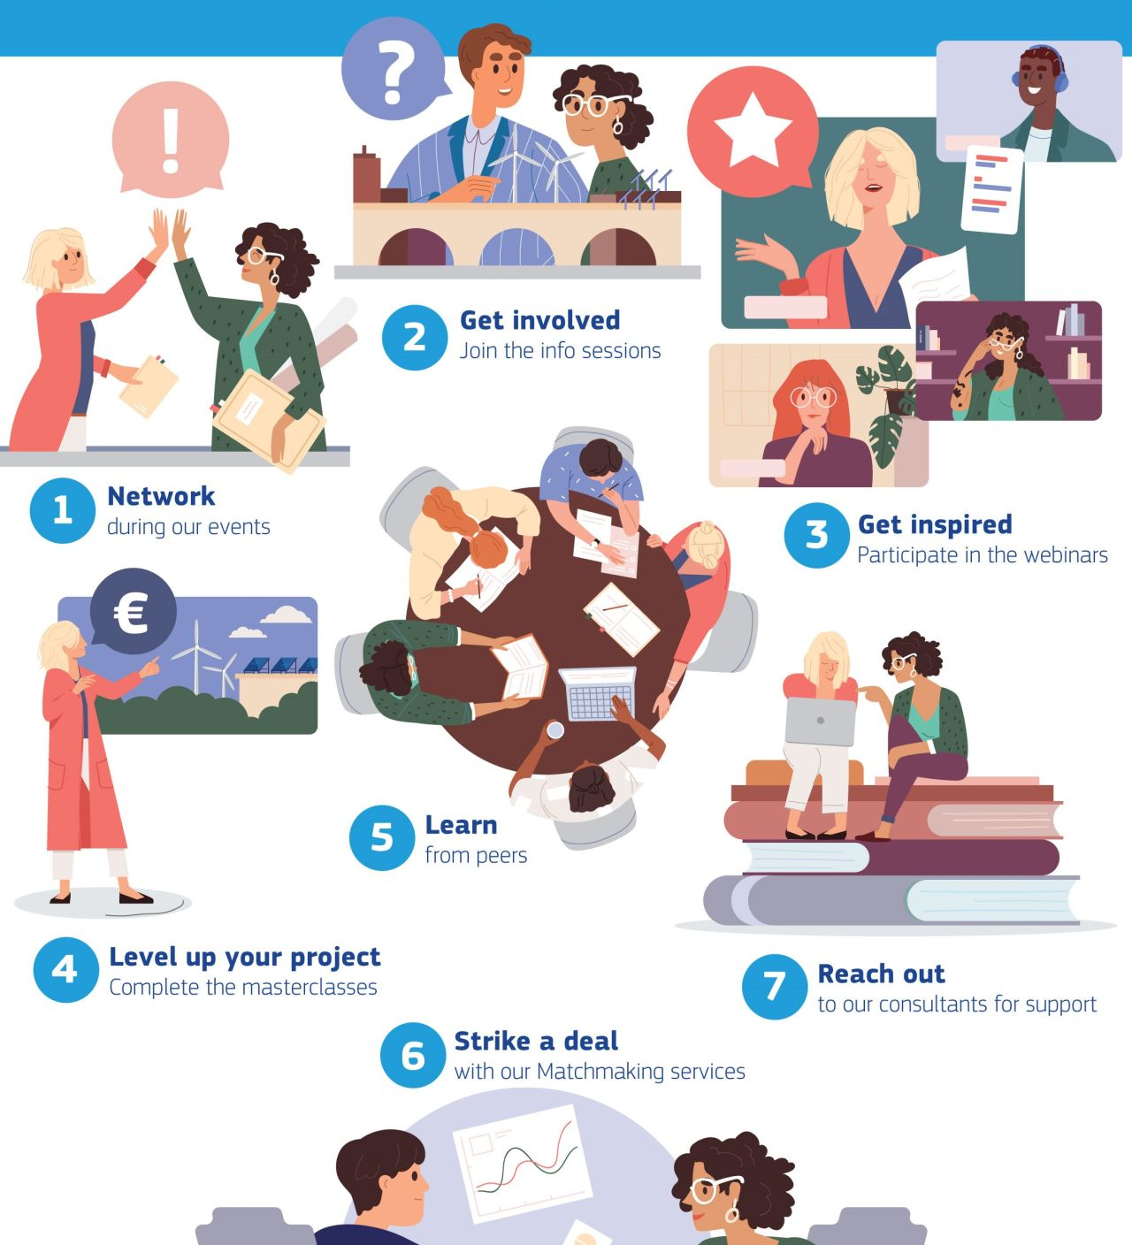
WHAT type of support is provided?
Accelerate the implementation of projects aiming at making your city climate neutral
Benefit from free-of-charge (financial, technical and governance) assistance
Receive personalised project support according to your interests and availability
Gain facilitated access to funding and financing opportunities
Join networking sessions with cities, technical providers, and other key players with interest in co-developing projects in the areas of clean energy, sustainable mobility and ICTs
Meet with investors to pitch and improve a project, get feedback, and build relationships for future investments

Slide 13
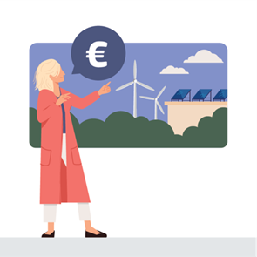
WHAT services are offered?
Matchmaking events
1-to-1 consultancy services (technical, financial, legal, engagement)
Online or in-person events where cities, consortia, and investors can learn about participating in projects that make cities smarter and more sustainable.
Tailored team of experts supporting a city or a city-led consortium in addressing the legal, technical, financial and governance-related gaps of a smart city project.
Financing masterclasses
Peer-to-peer exchanges
Hands-on guidance on how to improve the maturity of a project idea focusing on aspects like value for money, affordability, and bankability
Personalised meetings to enhance smart city and sustainable projects by enabling concrete learning from stakeholders that have already implemented similar activities.
Thematic Webinars
Deal meetings with investors
Real examples of best practice, latest trends, guidance for developing, investing in, replicating, or scaling up projects
Facilitated meeting between a city or consortium with interested investors to explore avenues for securing funds or financing for a mature project.

Slide 14
WHO can apply and HOW?
Cities and city-led consortia from EU Member States
Businesses, SMEs, and project developers encouraged to contact the relevant city administration(s) to see if a consortium can be formed
Investors
SCAN ME NOW!
https://smart-cities-marketplace.ec.europa.eu/matchmaking/call-for-application

Slide 15
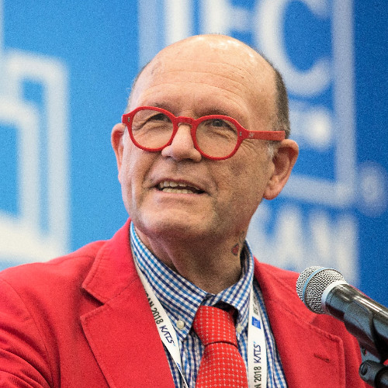
Speaker 1:
Michael Mulquin IS Communications LTD MiMs Ambassador at Open & Agile Smart Cities

Slide 16
Positive Energy Districts and MIMs
Michael Mulquin
michael@oascities.org

Slide 17
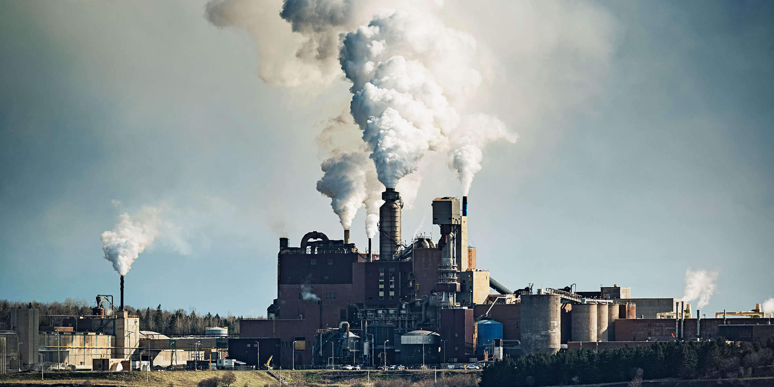
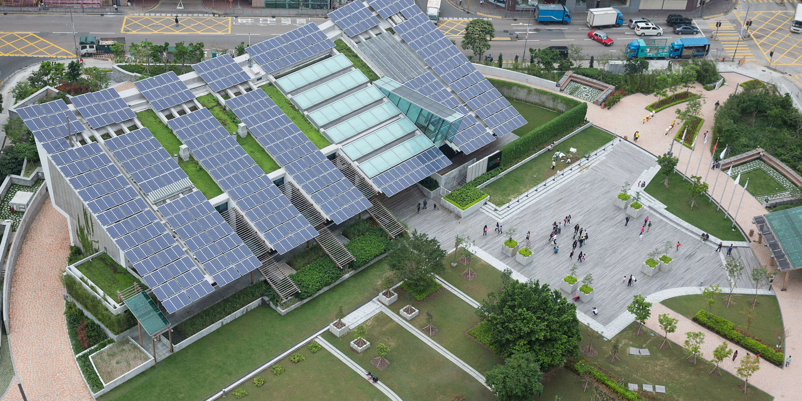
City & Energy
In our globalized world, cities are the hubs of communication, commerce and culture. They consume more than two-thirds of the world’s energy and account for more than 70% of global CO2 emissions. Urban areas are among the main originators of climate change, as urban activities are major sources of greenhouse gas emissions.
What our cities do individually and in union can therefore set the agenda for a sustainable future. Being on the frontlines of global climate change in this way, cities are also well-positioned to play a leadership role in driving global action to address it.

Slide 18
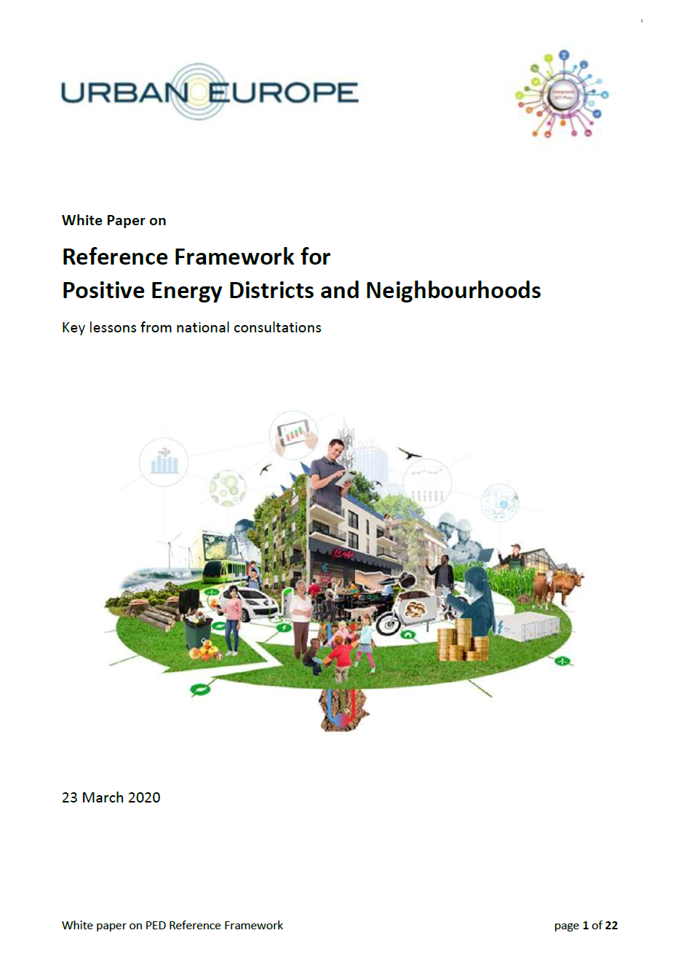
Emerging concept - Positive Energy District (PED)
In the last decade, efforts to develop solutions to reduce the environmental impacts of cities have multiplied, with the smart city concept being a promising one to cut greenhouse gas (GHG) emissions.
Smart city solutions are a set of integrated and holistic cutting-edge urban development strategies, based on ICT (information and communication technologies) applications, which contribute to urban sustainability and citizen welfare (Mosannenzadeh et al., 2017).
To accelerate the decarbonization of urban areas and foster the scalability potential across cities, the Positive Energy District (PED) concept was developed as part of the smart city strategy.
PED is an emerging concept intended to shape cities into carbon neutral communities in the near future.
[Source：IEA Energy in Buildings and Communities]
The Europe has implemented the PED Programme which has the ambition to support the implementation of 100 Positive Energy Districts and Neighbourhoods in Europe, to provide sustainable urban development as well as quality of life and affordability in the urban environment.
[Source：White-Paper-PED-Framework-Definition; Positive Energy Districts and Neighbourhoods (PED/PEN)]

Slide 19
What is Positive Energy District (PED)？
An energy-efficient and flexible urban area with net-zero energy import and greenhouse gas emissions, aiming toward annual local surplus of renewable energy.
[Source：João Pedro Gouveia, etc. Positive Energy District: A Model for Historic Districts to Address Energy Poverty. Frontiers in Sustainable Cities]
“Positive Energy Districts are energy-efficient and energy-flexible urban areas or groups of connected buildings which produce net zero greenhouse gas emissions and actively manage an annual local or regional surplus production of renewable energy. They require integration of different systems and infrastructures and interaction between buildings, the users and the regional energy, mobility and ICT systems, while securing the energy supply and a good life for all in line with social, economic and environmental sustainability.”
[Source：White-Paper-PED-Framework-Definition; Positive Energy Districts and Neighbourhoods (PED/PEN)]

Slide 20
Stakeholders of Positive Energy Districts (PEDs)
Healthy lifestyle
Green commuting
Increasing job opportunities
Citizen
Market demand/Talent supply
Happiness enhancement
Job opportunities/Green products
Livable living environment
Net Zero
Energy efficiency improvement
Industrial low carbonization
Economic transition
Intelligent management improvement
Governance capacity optimization
Business environment/Application scenarios
Industry
Economic upgrading and transformation
Government

Slide 21
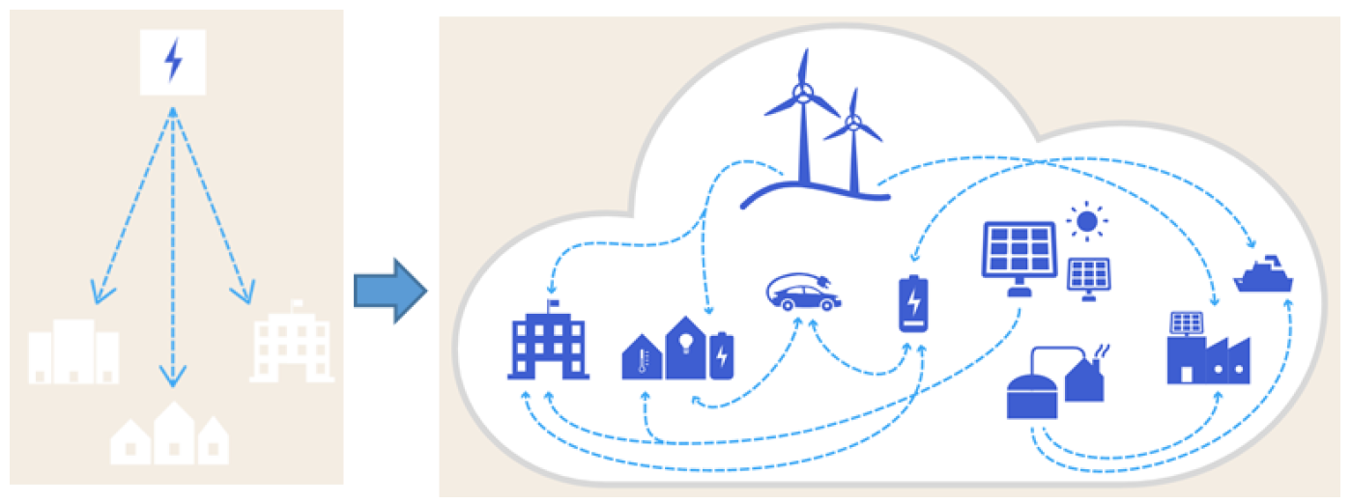
Use Cases of Positive Energy Districts (PEDs)
Europe Positive Energy Districts (PEDs)
Åland Island, Finland – Smart Energy Åland
Åland is an island with ideal wind and solar conditions and a separate independent electricity system. Installations of solar panels on both private and commercial buildings are steadily increasing and in wind power, Åland is a pioneer, with a wind power park that started to be built in 1994. Already today, our wind turbines can produce about 20 percent of annual energy consumption.
Focus of energy supply: Solar, Wind, Heat and CHP, bioenergy, wave power, geothermal, E-Storage
The main goal of the strategy for 2030 is to:
Reduce carbon dioxide emissions by at least 60% compared to 2005.
Increase the proportion of renewable energy to at least 60%.
Increase the proportion of locally produced renewable electricity to at least 60%.
Reduce emissions from road traffic by at least 50% compared to 2005.
Smart Energy Åland brings many direct and indirect benefits to Åland:
Jobs are created during the construction of new facilities.
Åland’s profile as a tourist destination and settlement is increased.
New companies are created with the development of new products and solutions for energy distribution.
For participating private actors and companies, Smart Energy Åland becomes an important reference, a platform for innovation and an opportunity to develop new business ideas.
Smart Energy Åland becomes a tool for Åland in the realization of the landscape government’s Climate and Energy Strategy.

Slide 22
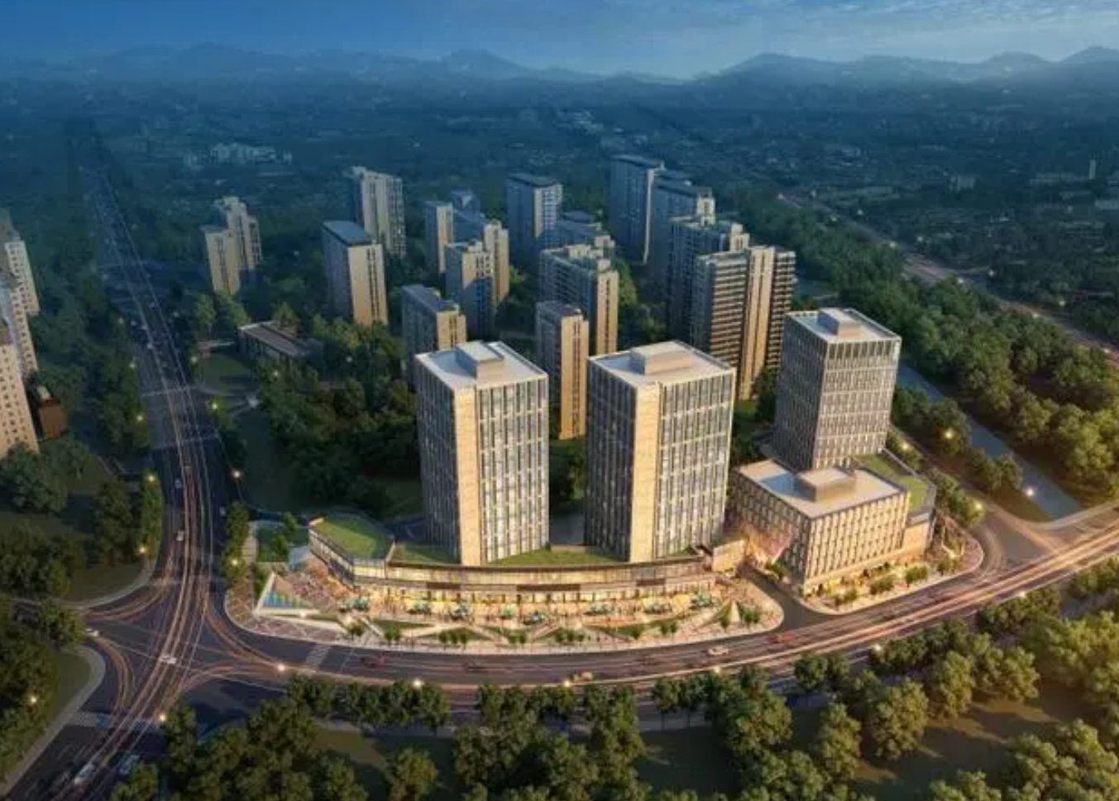
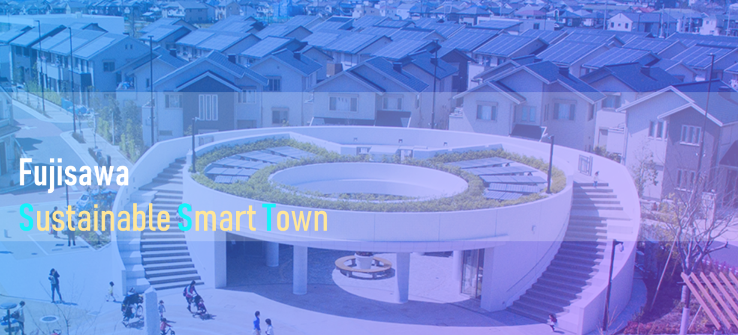
Use Cases of Positive Energy Districts (PEDs)
Beijing Changxindian Low-Carbon District
Energy utilization: establish geothermal heating system, use of clean energy, equipped with urban rainwater collection facilities.
Residential: 20% of residential units are wheelchair accessible.
Transportation: Advocating green transportation and a variety of low-carbon construction and lifestyle will reduce the carbon dioxide emissions of this large community by at least 50% compared to the conventional community.
Fujisawa Sustainable Smart Town
Roof structure is fixed with modern solar panel technology that both powers the house and banks unused energy in a home­based storage battery.
Transportation infrastructure is designed with electric vehicles.
Networked sensors all over the town will control things like public lighting，insuring power doesn't go to waste.
Equipped with modern green technologies rather than less­ efficient older technologies.

Slide 23
Smart City and Positive Energy District (PED)
Analytics
Modelling
Fair and transparent
Exploiting synergies
AI enabled
Local Digital Twins
CIM
Support government decision-making
Smart Cities
Low-carbon living guidance
Energy efficiency management
Net zero
Low-carbon lifestyle
Internet-driven
Optimize resource allocation
New business model
Service Network
Demand response
Integrated energy service
Power big data
Energy distribution and consumption
Smart home
Intelligent Building
Public space
User interaction
Energy Optimization Allocation Network
Electric vehicle
Intelligent Communities
Public lighting
Optical fiber backbone network
Power fiber to home
WiFi、5G
Dispatch network
Internet of Things
Internet of Vehicles
ICT
PED
Electrical service network
Public service platform
High proportion of clean energy
Active distribution network
Distributed energy Smart microgrid
Gas fired power station
Biomass power generation
microgrid
Energy physical network
Energy strorage
Wind power station
Distributed generation
Charging station

Slide 24
https://oascities.org/

Slide 25
https://www.bi-ped.eu/

Slide 26
https://expedite-project.eu/

Slide 27
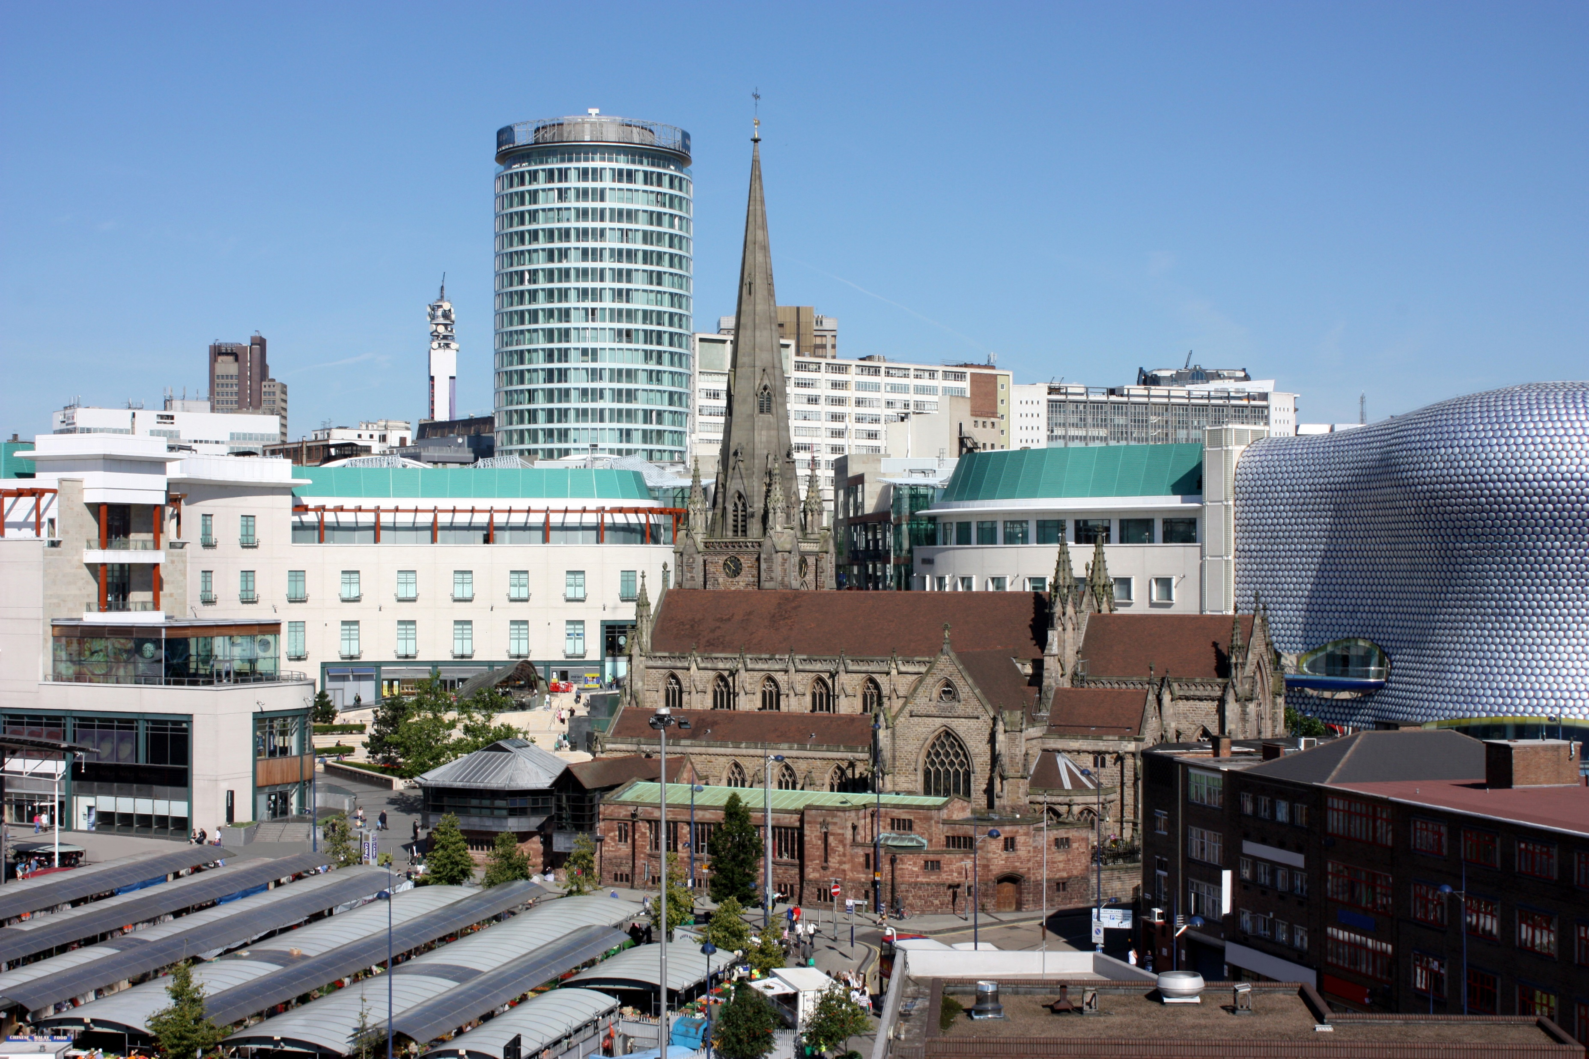
There are many sub systems in a PED
They therefore need to share data to help manage those interactions
All these systems generate data and require good data to work well
They all interact with each other at many levels
How to enable data sharing to deliver value?
People and businesses
Utility use and generation
Communi-cations
Shopping and Commerce
Health
Education
Transport & logistics

Slide 28
Managing PED data is complex
The city administration does not provide all the services in these different systems
Many are provided by other government agencies, private companies and not-for-profit organisations.
Some are big and well resourced; others are small but still important
Each will have their own processes to collect and handle data

Slide 29
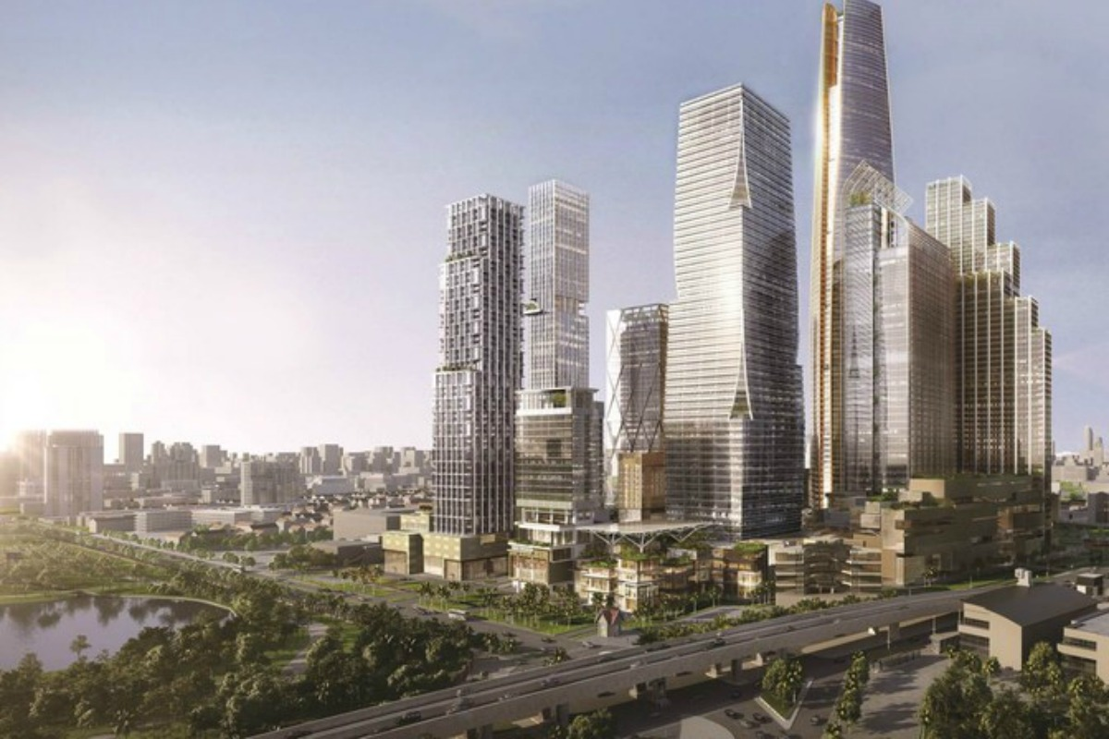
Many obstacles to data sharing between agencies!
?
?
?
?
How to ensure fair AI
?
How to ensure data quality
How to handle data analytics
How to manage data security
How to use data to manage physical assets
?
?
?
How to manage personal data
?
How to ensure common data models
How to gather data usage information
How to link context data
?
?
?
?
How to find out about the conditions for data sharing
How to agree compliance with conditions for data sharing
How to find the data I need
How to manage geospatial data

Slide 30
The work of Standards Organisations
Standards Development Organisations are developing many comprehensive and detailed sets of standards to help cities and communities tackle these issues.
Different standards committees are addressing different of these challenges.
If cities and city service providers would all follow the same sets of detailed standards, then data could be shared easily!

Slide 31
However, …
Standards from different Standards Organisations are not always compatible
Standards can also be complex and difficult to implement
Some valuable data is generated using proprietary systems, which may not be standards compliant
City data is gathered and used by many different organisations, with their own ways of handling the data

Slide 32
Degrees of interoperability
System A
System B
“Plug & Play” standard defined
Interfaces can
be transformed and/or mapped
Interfaces use a common model
No common standard. Requires
completely customised integration

Slide 33
Minimal Interoperability
The capability of systems or units to provide and receive services and information between each other, and to use the services and information exchanged to operate effectively together in predictable ways with minimal user intervention

Slide 34
Minimal Interoperability Mechanisms (MIMs)
The MIMs came out of some early projects where cities were beginning to experiment with using the data from IoT to develop applications such as smart parking.
The challenge was to identify a common way for cities to collect and manage the data to enable applications developed for one city to be easily ported to another
Also, to enable data coming from one application in a city to be used in other applications in that city
The MIMs are developed by Open & Agile Smart Cities & Communities (OASC) and by the Living-in.EU movement

Slide 35
What are MIMs?
Minimal Interoperability Mechanisms (MIMs) address the practical challenges of supporting data sharing between organisations that may use different standards or proprietary solutions in the way they collect and handle data.
Rather than require all organisations to change their existing practices and use precisely the same set of standards, MIMs propose simple modifications that will enable “good-enough” interoperability.
Their use simplifies the task of aligning data sets coming from different organisations and enables a useful data sharing ecosystem to be speedily and easily put in place.

Slide 36
The list of MIMs being worked on by Open & Agile Smart Cities
MIM | Function
MIM1: Context | Data sets/streams can be linked according to context
MIM2: Data Models | All data sets/streams use consistent data models
MIM3: Contracts | Appropriate data sets/streams can be found, and agreement can easily be reached for their appropriate use
MIM4: Trust | Citizens can be actively in charge of how data about them is used so that it can benefit themselves and their community
MIM5: Transparency | Decision making algorithms will use data appropriately to make fair and transparent decisions
MIM6: Security | Data can be held and shared securely
MIM7: Places | geospatial information can be accurately described in consistent ways
MIM8: Indicators | KPIs can rely on consistent data from across the ecosystem to enable reliable measurement of progress
MIM9: Analytics | Models and analytics used within the ecosystem can work well with other models and analytics
MIM10: Resources | Information about city related resources can be appropriately shared

Slide 37
There will be other MIMs later
The 10 MIMs are designed to help data flow and be useful in a local community, but others will need to be added to make sure all the gaps are filled.
This is particularly as cities begin to implement data spaces, local digital twins and the MetaVerse, where, for instance, we need to start to consider minimal but sufficient interoperability between models and not just data.

Slide 38
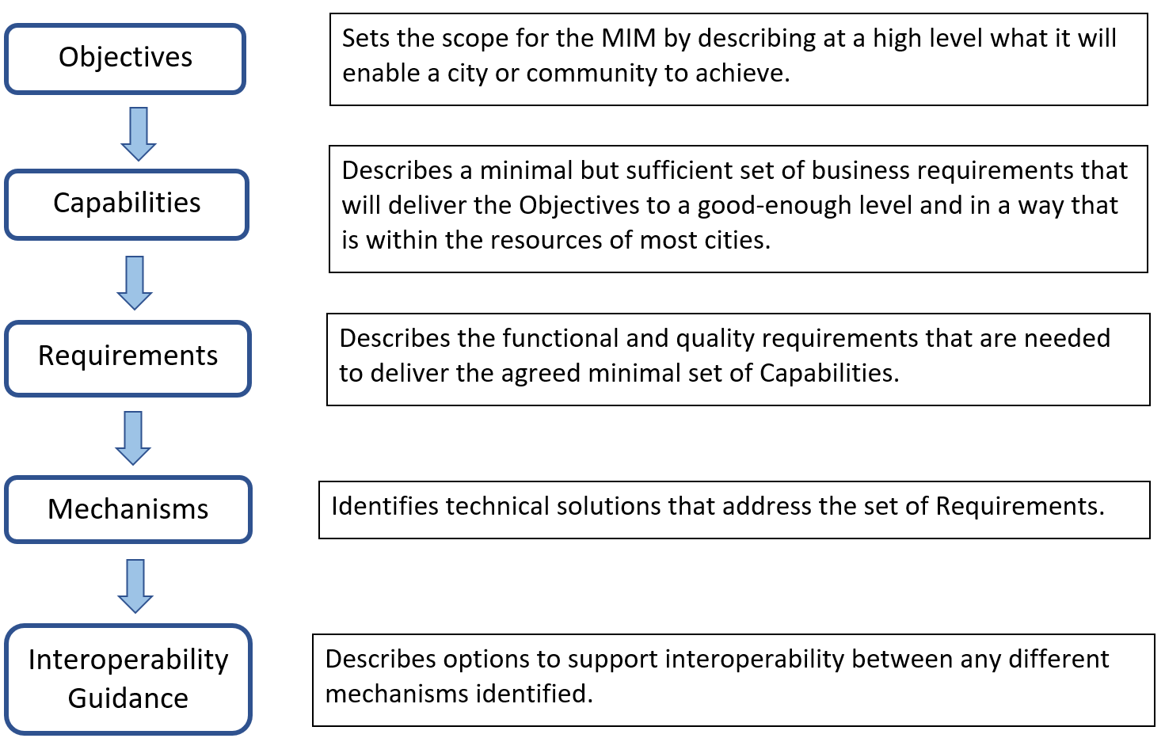
The format for each MIM
In addition, guidance will be given on conformance and compliance testing

Slide 39
Questions? Comments?

Slide 40
Speaker 2: Ward Steeman IT & Smart Cities Project Manager

Slide 41
From Thermocar to Therm’ai’
Ward Steeman

Slide 42
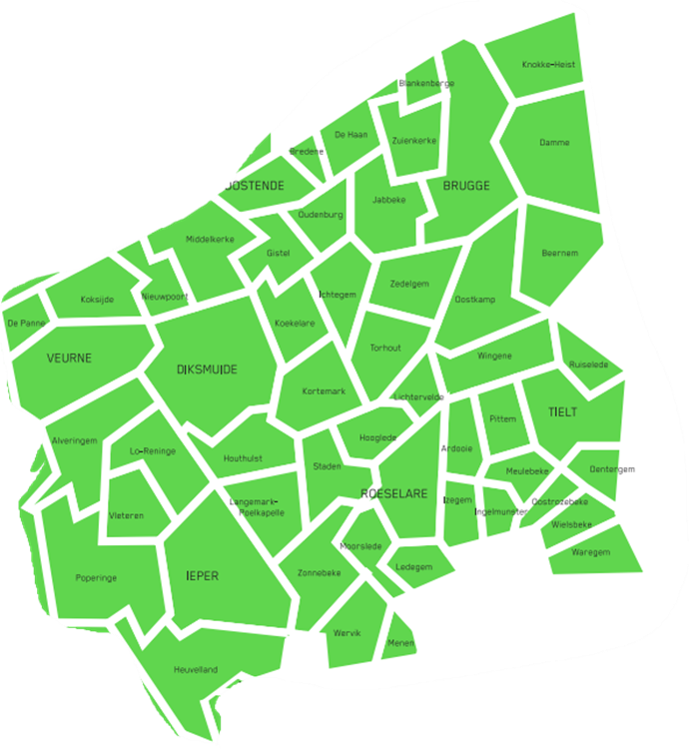
West-Vlaamse Intercommunale
intermunicipal company
Services and investments that support local governments in their transition to sustainability, clean energy, mobility, housing, entrepeneurship
54 municipal governments
Smart City approach

Slide 43
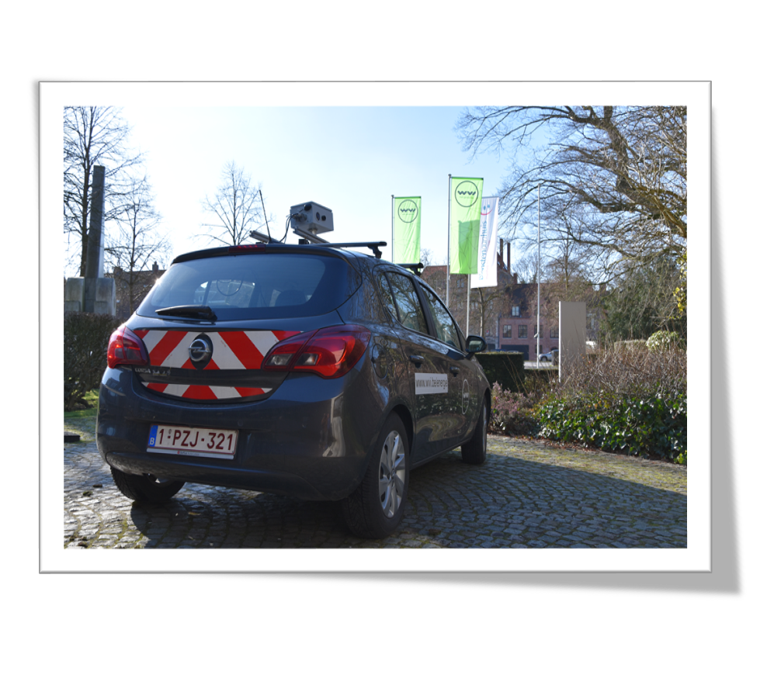
Thermocar
Drive-By concept
During winter time
2 cars, 2 thermografic camera’s on each car
Since 2018, gradually improving operational efficiency, reducing manual work thus reducing cost per picture

Slide 44
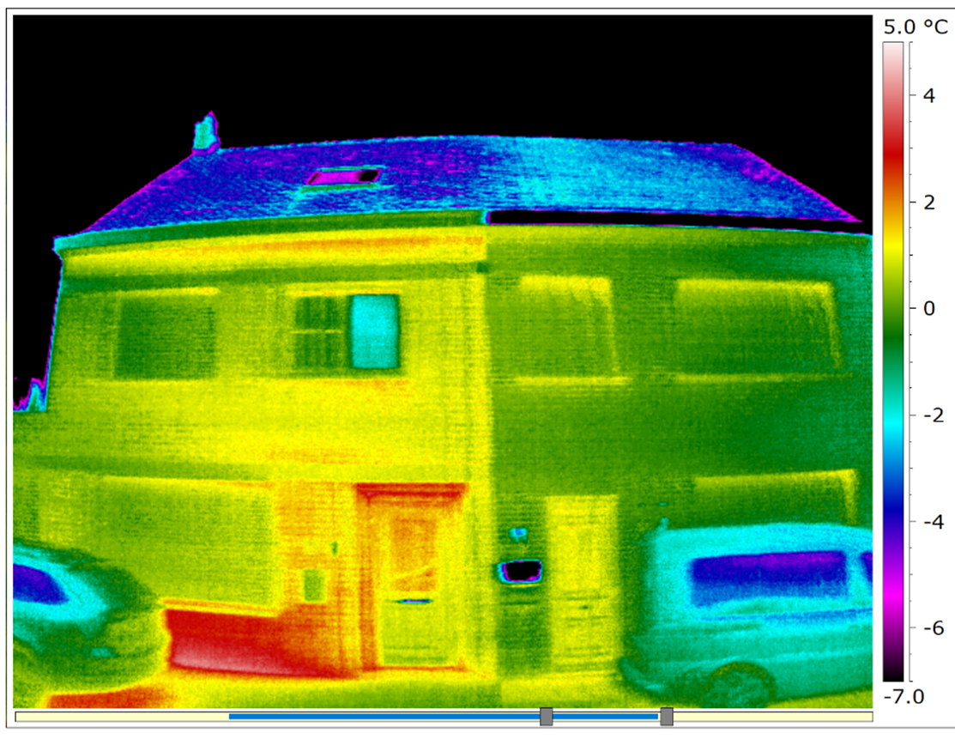
Main goal: Showing energy loss to house owners, triggering them to renovate their roof, facade, windows,..
A smart approach directly reaching citizens
currently house owners are invited to receive an analysis of their house (ad hoc, on request)

Slide 45
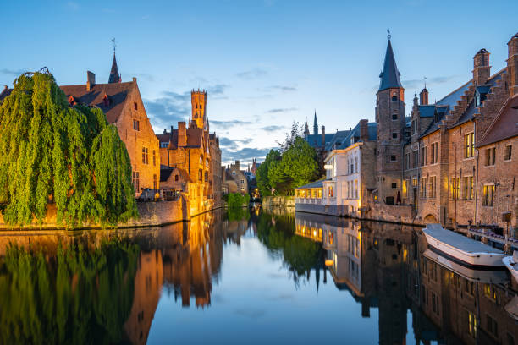
THERMAI

Slide 46
Thermai project
By using AI, we achieve to further avoid manual work: automatic interpretation of pictures.
As a result, more people could be reached, both ad hoc (as today) or in an digital way (available online).
By combining the data of the individual houses, we can better support municipalities when they focus on bigger neighbourhood projects.
Data can be used as a dataset as part of economical analysis.
But…

Slide 47
Quality of the camera?
Quality of the pictures taken?
Kalibration issues?
Available metadata?
Techniques to improve quality?
Image segmentation?
Image selection?
Stitching techniques?
Combining open data with the camera data to identify every house?
Image interpretation?
Questions: w.steeman@wvi.be

Slide 48
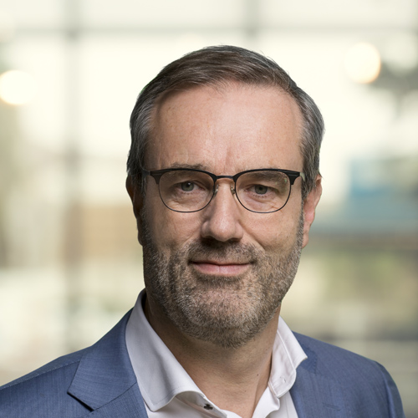
Speaker 3: Bart Vuijk Senior Business Developer Mobility

Slide 49
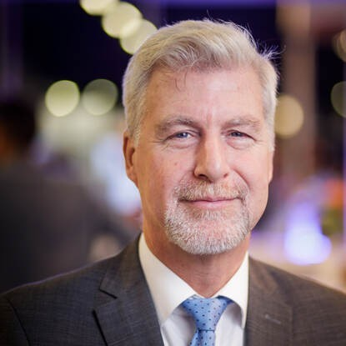
Speaker 4: Caspar de Jonge Program Manager for Mobility & Transport
Ministry for Infrastructure & Water Works
DMI Ecosystem

Slide 50
Accelerating smart and sustainable urbanisation through cooperation and technology
Caspar de Jonge
20 February 2024

Slide 51
340+
National Government Programs in Physical Domain
35+
Leading -
although sometimes conflicting - principles
489
Current agreements between Ministry and mid-size cities
440+
Smart City pilots

Slide 52
DMI: a structured public-private ecosystem
Four strategic pillars
...currently structured in eight content themes (and expanding)
Maximum utilisation of information technology
Cross-domain policy coordination (multi-level)
Structuring and organising ppp
Knowledge, monitoring, standardisation and best practices, skills
Smart Urban
Development
Mobility hubs and Housing
City
Logistics
Circularity
& Energy
Public
Mobility
Community
Driven
Approach
City
Traffic
Collective
Data
Services

Slide 53
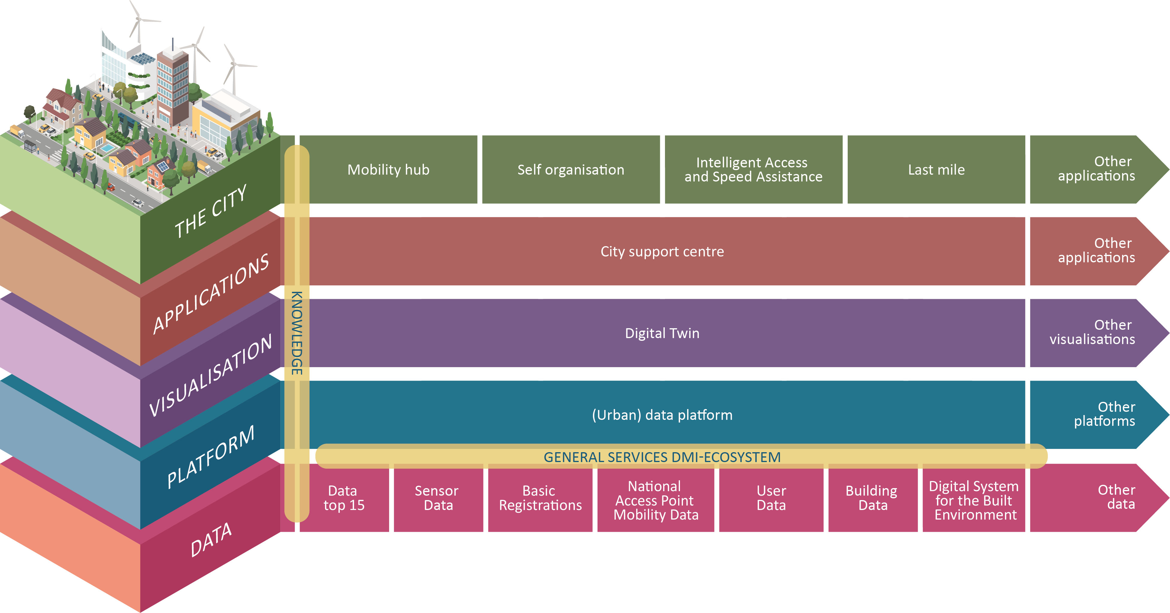
DMI: a scalable approach
Public-private collaboration
Scalable solutions
Combined dataspaces
Vendor independent

Slide 54
Federated data sharing: set of collective agreements
Products and Services catalogue (shop window) incl. national data registers
IAA (access control)
Clearinghouse function (monitoring and accounting of transactions)
Privacy check
Registers for sensoring and algorithms/AI
Commons: sharing knowledge, products and services
Monitoring and Supervision

Slide 55
Information technology, focusing on.....
Scalability and interoperability
Ethics, Privacy & Data Protection
Making and keeping agreements
Standards (international by default)
Open interfaces
Fit for purpose
Management
Affordability:
For end users
For governments
For business community
For producers/service providers

Slide 56
Example from the real world: Apeldoorn
Parking policy
Location policy
Shared mobility
Hub network
Charging infrastructure
Building permits
Energy, water retention and green public spaces

Slide 57
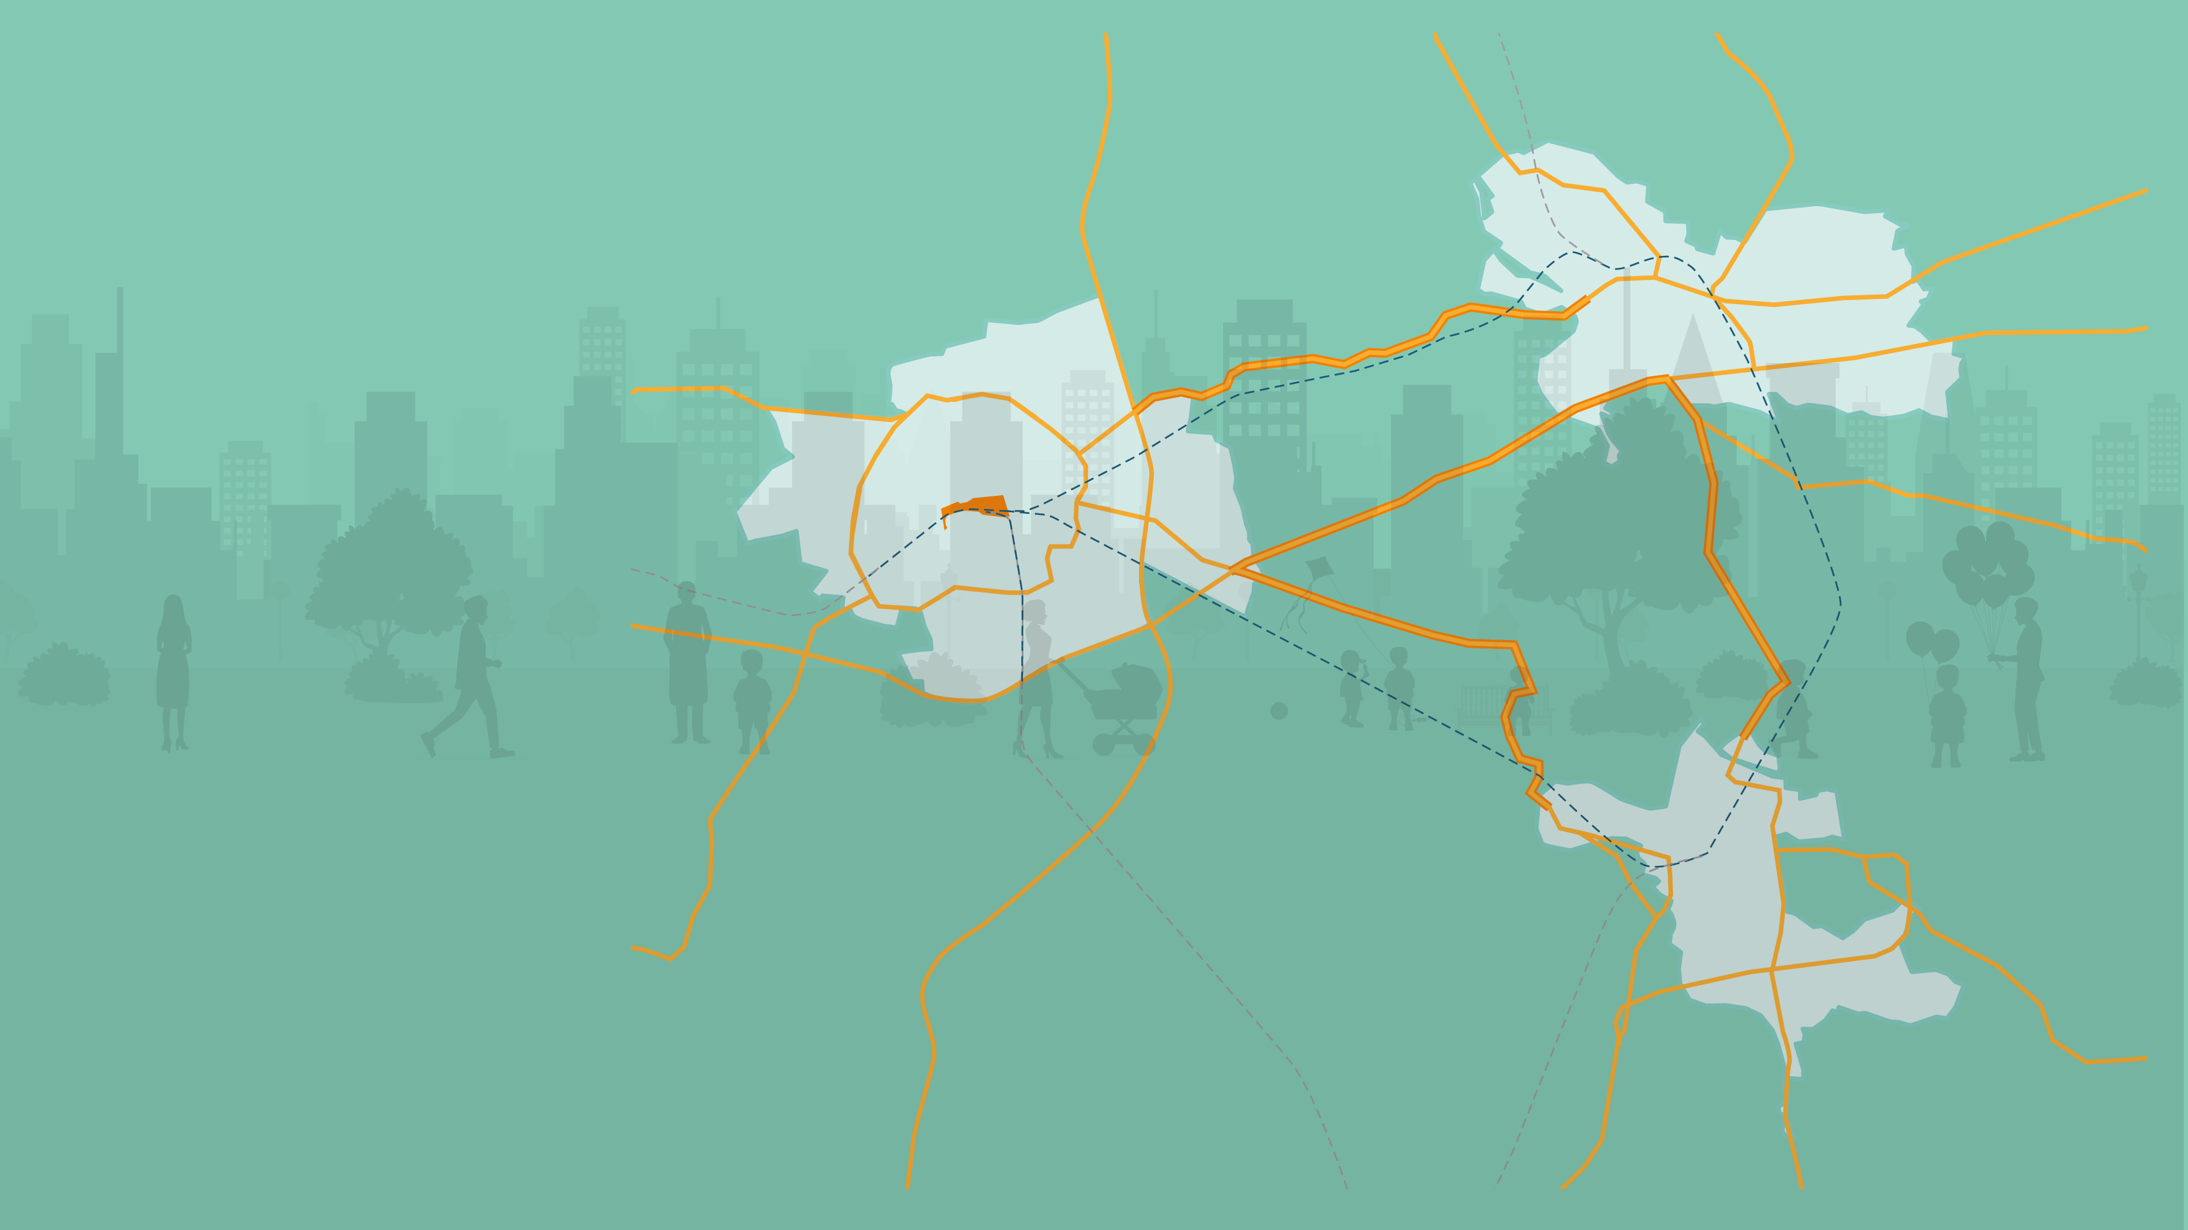
Apeldoorn as part of a region
Regional Mobility Plans (RMPs) & SUMP’s
Daily Urban System
Employers and employees
Transport of goods
Recreational traffic
Energy grids and generation

Slide 58
Province of Gelderland’s responsibilities
Public transport authority
Road authority
Road safety and environmental impact
Spatial planning
Environmental issues (industry, agriculture)

Slide 59
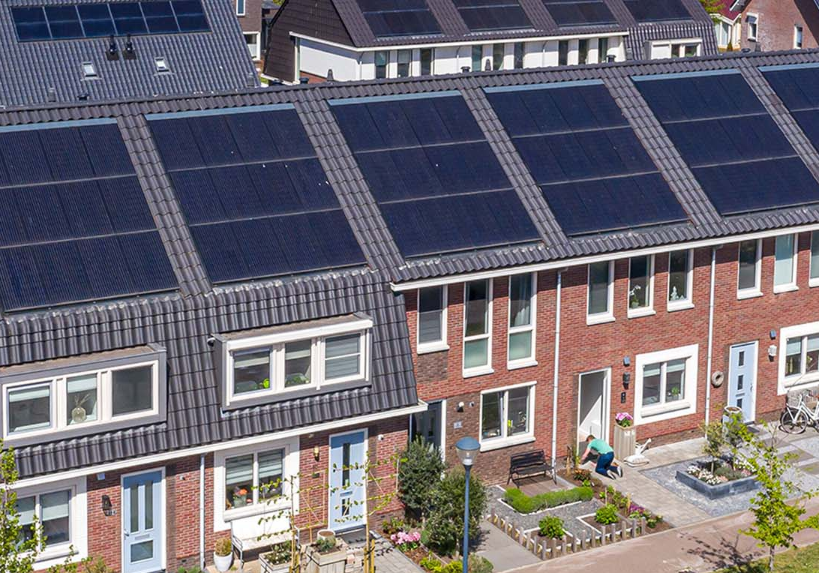
Policy coordination
All new buildings could/should be equipped with solar panels, but energy grids are stretched to max. capacity Amending the Building Code and rewarding the 'forerunners' in the run-up to it? Obligation to build circularly: to what new standards & best practices? How to monitor the net reduction in energy, waste, transport?

Slide 60
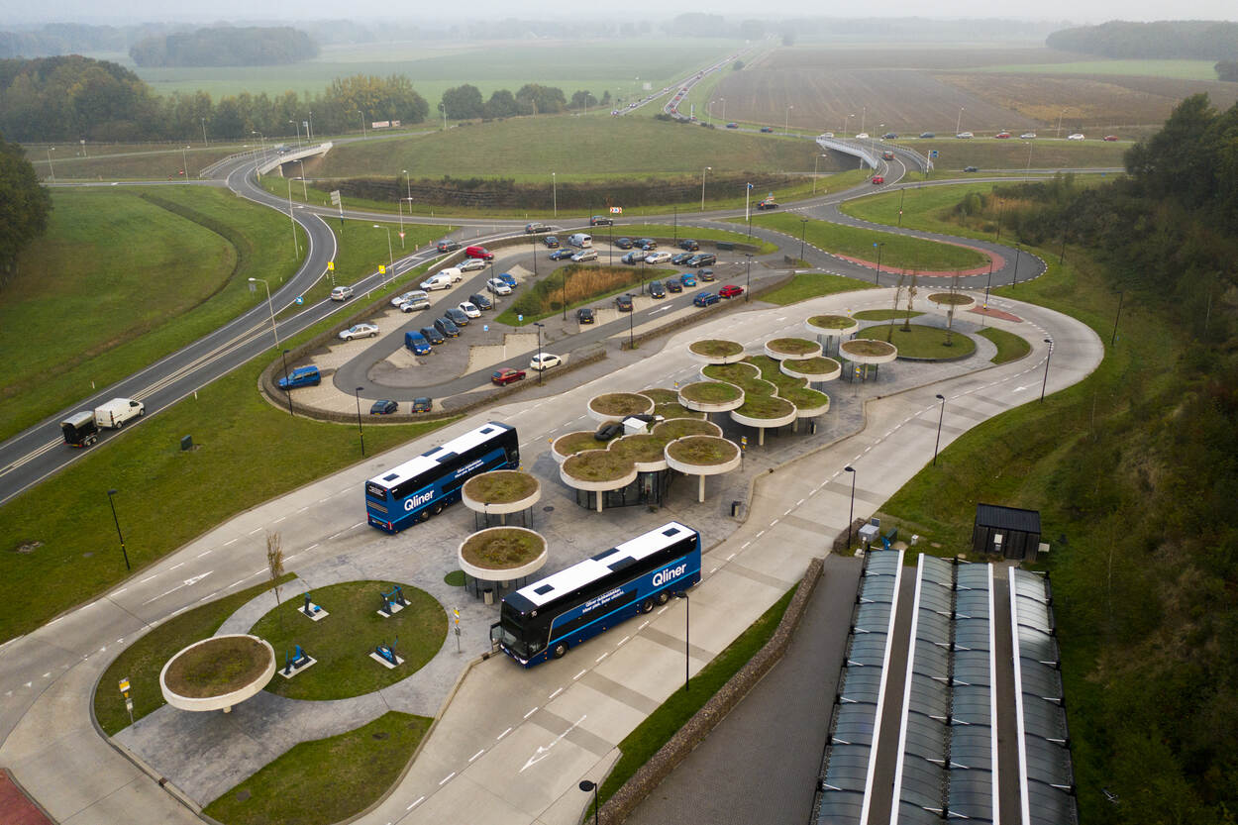
Hubs, energy and circularity
Investing 800 million in construction, but how....
How do we measure the use and impacts?
How do we plan the energy demand and use in relation to the grid capacity?
How can we ensure local green energy production & consumption?
How do we manage availability of assets and capacity (V2G & V2H)?

Slide 61
Energy & AI
Housing, EV’s, Hub’s: increased demand
Energy grids at full capacity
Data (production, use, user rights) not yet available
Individual & collective: different scales
First examples of energy cooperations emerging
Load balancing
Peak shaving
Regulatory framework
Data agreements
Local, regional urgency vs. national policies & national investment strategies
Governance related to local cooperations
We very much welcome your knowledge, examples and experiences

Slide 62
Thank you for your attention
More information on how to join DMI?
Please check www.dmi-ecosysteem.nl/en
Email: DMIteam@minienw.nl

Slide 63
Panel discussion and Q&A

Slide 64
FOLLOW US AND STAY IN TOUCH!
Website | Newsletter | Twitter | Linkedin | YouTube | Podcasts
smart-cities-marketplace .ec.europa.eu | ec.europa.eu/newsroom /ener/user-subscriptions /1759/create | /eusmartcities | /company/eusmartcities/ | /smartcitiesmarketplace | audiovisual.ec.europa.eu/ en/podcasts#C-000010
Smart Cities Marketplace | Matchmaking Team | matchmaking@smartcitiesmarketplace.eu
Notes:
@EUSmartCities 14,3K followers
www.linkedin.com/company/eusmartcities/ 4,755 followers
www.youtube.com/c/SmartCitiesMarketplace 860 subscribers
Newsletter subscribers 2549 people

