Slide 1
EU Smart Cities and Communities information system
Branislav Iglár
AIT Austrian Institute of Technology
Center of Energy

Slide 2
What is SCIS?
Repository of best practices and lessons learnt
EU funded projects
Extract the minimum amount of information that is necessary in order to replicate a solution
Data collection & analysis
Visualisation of KPIs
General assessment of a specific development of projects
SCIS is NEITHER an audit NOR a comparison of projects
No verification of results, only analysis
No rankings
SCIS does NOT substitute the project’s website

Slide 3
SCIS‘ outcomes
SCC, EeB & EE projects:
Solutions & Data
Database & Website:
Technologies | Demo sites | KPIs | Solutions | Recommendations
Stakeholders involved in impl.
Policy makers
Experts

Slide 4
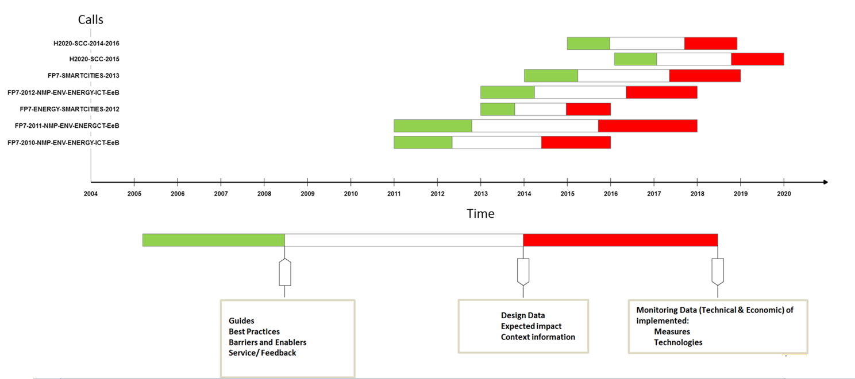
Challenges
Data is public
Accessible for the user – open data
Reduce double efforts
KPI calculation
Described in the KPI guide
Double check: by SCIS and by the projects
Different stages / maturity →
Data is used
Assessment
Consultation
Minimum requirements
Large number of technologies
Overview of what works

Slide 5
Conclusion
Unify criteria and ensure consistency
Clear structure
Minimum data requirements to ensure a proper assessment of the Smart Cities projects performance
Cross link of SCIS and other initiatives (CITYkeys), standardisation processes (ISO37120), projects etc.
Adapt and include KPIs towards ongoing European developments and targets
ICT
Mobility

Slide 6
SCIS & UN SDG-U4SSC
SCIS is on a different level – complementary assessment to strategies supporting stakeholders involved in smart city project development and implementation
Contribution to a big picture of different series of KPIs
Not competing
No inconsistency
Different but aligned levels support SCC strategies, projects and their replication
SCIS provides added value
Specific progress of projects
KPIs for project assessment and management
Communicating performance and impact of certain implementation to stakeholders for replication

Slide 7
Recommendations
Combination of quantitative and qualitative information to provide context turned out to be the best way to support replication
Municipal administrations see low contribution of commercial indices to their work
KPIs rather for assessment than for comparing
The results show that the application of KPIs to assess design and monitoring data can point out a gap that represents a certain problem in the implementation
Clear and common framework necessary - detection of inconsistencies by applying a common KPI/assessment framework, esp. for financial assessment
Cross-referencing is key – European framework can give an important contribution but cannot solely define on international level (e.g. ISO developments)

